Slide 1
Rapid Business Driven Testing
Presented At Test & Performance Conference
November 2006
Clyneice Chaney,CQMgr., PMP, CQA
Project Performance Corporation
cchaney@ppc.com

Slide 2
Why Rapid Testing
Structured Testing
Structured Testing
Automation
Detailed
& through
Preparation
INSTALLATION
MORE CHANGES
P
R
O
D
U
C
T
I
O
N
TESTING
TESTING
The SQUEEZE!
DESIGN AND
CODING
MORE REQUIREMENTS
PROJECT LIFE CYCLE
Notes:
Who’s paying for slow testing? No one. In an ideal world rapid testing would not be necessary., but most development projects there is often schedule crunches and times when a quick assessment of the product quality is necessary.
Structured testing is a vital part of any development project. However, there are times when other techniques such as rapid testing must be utilized. The problem is that almost no one is given the time and resources to properly execute a through test process. Rapid testing is a way to scale thorough testing methods to fit arbitrarily compressed schedule. It doesn’t mean “not through”, but does mean as through as reasonable given constraints on time.

Slide 3
Rapid Testing Defined
Rapid testing is considered a powerful techniques used to complement conventional structured testing
Notes:
What does rapid testing really mean.?
Rapid testing is a technique pioneered by James Bach and is based on exploratory testing techniques and used when there is too little time to obtain full testing coverage using conventional methodologies. Rapid testing is designed to find the biggest bugs in the shortest amount of time and can provide a high value for testing dollars. In addition to exploratory testing techniques, my approach to rapid testing also involves a process improvement approach that seeks to gain efficiencies in the test process to promote rapidity. IN short,
Rapid testing is a technique based on exploratory testing .
It is used when there isn’t enough time for full testing converge with conventional testing
It is Designed to find the largest number of defects in critical areas in short time frames.
And it Involves process improvement in the testing processes itself.

Slide 4
Looking For Efficiencies & Rapidity
Rapid Testing
People
Integrated
Test
Process
Static
Testing
Dynamic
Testing
Rapid Testing: Brown, Cob, Culvetson ,Prentice Hall, 2002
Notes:
There is no simple way to achieve rapid testing. This slide presents rapid testing as a structure built on 4 components. These components, people, integrated test process, static testing and dynamic testing represent the central activities of a structured testing process. If any are weak, then effectiveness of rapid testing is impaired. For rapid testing must optimize these four components in order to gain efficiencies that you normally don’t have when employing structured techniques.

Slide 5

People: Rapid Testing
More experienced testers
Technical backgrounds
Strong analytical minds
Good at breaking things
Notes:
If you are looking for the single biggest contributor to your team’s ability to test a product quickly and effectively, the quality of the people on your test team is an obvious place to look. Again novice and business oriented testers have a place on the test team, however they are not your best candidates for achieving rapid testing.

Slide 6
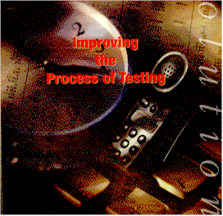
Gaining Efficiencies Test Process Improvements
Quick estimation
Quality Standards
Build Management
Rapid Reports
Risk Based Testing
Risk Test Management
Notes:
The 2nd critical area of a structured testing process is the integrated testing process itself. A testing process includes how you plan, estimate, manage, execute and report on testing. The items listed here: quality standards, risk based approach, risk management are not new topics in conventional testing. They are listed here because a focus on these topics provided :
Ways to gain efficiencies to get rapidity in your testing.
Or they are a key factor in the actual success of risk based testing approach
This concludes the modules where we are looking at techniques that can gain efficiencies in the test process itself. We covered:
This section Module – through --- provide information for gaining efficiencies in areas associated with the

Slide 7
Test Process Improvements: Quality Standard
Determine Quality Standard Up Front & Early

Slide 8
Quality Models
Portability
Reusability
Interoperability
Maintainability
Flexibility
Testability
Product
Revision
Product
Transition
Product Operations
Correctness Reliability Efficiency Integrity
Usability
McCall Quality Model
Notes:
The McCall quality model is organized around 3 types of quality characteristics: factors to specify: they describe the external view of the software as viewed by the users; criteria to build: they describe the internal view of the software, as seen by the developer
Metrics to control, they are defined and used to pride a scale and a method for measurement.

Slide 9

Test Process Improvements: Rapid estimation
Classic Estimation Mistakes
Missing potential integration system problems
Missing time required defect fixes
Missing time handle unexpected problems
Incomplete requirements
Changes to requirements
Overestimating tasks
Ignoring time needed for training
Including overtime in initial plan
No buy-in from people doing work
Unrealistically adding people to late tasks
Notes:
Use industry standards as baseline for estimates
Begin tracking estimate actual
Collect use historical data to fine tune estimates

Slide 10
General Testing by Category Rules of Thumb
Manual Levels of Testing | Percent of Total Programming Phase Effort
Unit | Write specification = 33% Write Code =33% Unit Test =33%
Integration | 20-40% of Programming phase Strategy Plan = 10% Test Case Design = 30% Execution = 60%
Acceptance | 15-30% of programming phase

Slide 11
Test Case Development Rules Of Thumb
Measure | Test Cases
Number of Features (simple, low risk) | 1-2 test cases
Number of Features (complex, high risk) | 10-20 test cases
Executable File | 3-4 test cases per 100 KB of executable (simple) 30-45 per 100 KB for complex
Input Transaction(per data field) High risk data field/ input transaction Interrelationships (btw data fields) | 2 test cases (+/-) 9 test cases 2 Test cases (+/-)
Modifications to Existing code (small) | N% of code is modified, Test cases is n# of original test cases
Modifications to Existing code (small) related but un modified components | Comprehensive testing = same num as new Light or regression = 10% of num test cases for new software
Collard & Company Test Estimation Workshop

Slide 12
Specialized Testing Rules of Thumb
Type of test | Importance low | Of Test Mod | High
Cross Platform test | 2-5% | 5-10% | 20-35%
Regression Test | 2-5% | 15-25% | 100%
Usability | 2-5% | 5-10% | 20-35%
Performance/Stress Test | 2-5% | 5-10% | 20-35%
Security & Control Test | 2-5% | 5-10% | 20-35%
User Acceptance Testing | 2-5% | 5-10% | 20-35%
Collard & Company Test Estimation Workshop

Slide 13
Calculating Execution
Total person hours of planned testing (# test cases X estimated time to run)
How many raw person hours of staff time is available
What percentage of testers time will be spent running test cases
100 test cases X 1 hour(setup, record defect) = 100 hours
2 staff working 40 hour week = 80 hours per week
75% time test execution = 60 hours person time per week for execution
One run = approximately 8 days
Notes:
30 hours in 5 days per person so 60 hours of person time
3 additional days or 40 hours for the remaining execution

Slide 14
Test Process Improvements: Influence Build Strategy
Functionally independent piece of software
Supports a well-defined logical sub-set of a system
Tested independently
Integrated with other builds.
Notes:
After high-level requirements are defined, the next step is to develop the build strategy. Builds are groupings of major requirements, so the build strategy cannot be defined until at least the major application requirements are defined. The build strategy defines how code units are developed and grouped into builds and how builds are tested to verify that the high-level requirements are satisfied.
The success of testing depends at least in part on proper subdivision of the application into builds. A clearly defined build structure that breaks the application into manageable pieces in a logical and meaningful manner must be developed. The Build Strategy is an input into the test planning process.
Builds are typically the unit of transfer from one testing level to another (i.e. from Integration to Acceptance). One or more builds may be placed into production as a release without waiting for completion of the entire application.
Differences Between Builds and Releases:
Builds:
‘Builds’ relate to the way the development and testing teams create and test an application before delivery to the client. Build contents and sequencing are defined based on both the technical design and the most efficient use of resources in the development and testing effort in addition to priority of functionality.
Releases:
‘Releases’ relate to the delivery of functionality to the client in production status, typically based on the client’s urgency. An individual release may or may not be developed using a build strategy. More efficient use of resources
Earlier testing of critical functions
Reduced elapsed time for testing
Earlier business stakeholder feedback
More detailed status reports
Reduced complexity for testing and debugging
Focus on decomposing requirements
Identify defects before construction
Testing proceeds faster
Fewer test cases needed
Experience from early builds helps future tests

Slide 15
Developing and Testing By Builds
Build 1
Completed Application
A
A
Build 3
Build 2
B
D
B
D
C
E
C
E
PROGRAMMING
Build 1 Build 2 Build 3
TESTING
Build 1 Build 2 Build 3
Notes:
The build strategy is concerned with grouping high-level requirements into builds and their impact on the total testing effort. Builds are transferred from one testing level to another. When all the code units in a build have been successfully coded and unit tested, the build is transferred to the next level of testing, the integration test level. The new build is first tested by itself. When the new build has been tested satisfactorily by itself, it is integrated with all previously tested builds and the combined builds are then tested as a group. As each build or group of builds completes integration testing, it is ready for transfer to the final acceptance phase of testing. Builds may be transferred singly, or as a group. When acceptance testing of these builds is successful, the functionality may be installed, depending on the release strategy.
Based on this description of how builds are used, the build strategy is the key to planning the application's construction and testing. A high-level requirement may be satisfied and tested in one or more builds. For example, a requirement for online help requires an interface from each online build, and must be tested in each of these builds. Further test planning, including writing test cases, always requires decomposition of requirements to the detail level.
This slide show us how the build strategy allows the project team to efficiently allocate its development and testing resources. Once all of the code units in Build 1 have completed Unit test and are moved to the integration testing environment, the test team may start integration testing of that build. While the test team is working on Build 1, the developers are now free to work on the code units in Build 2. When Build 2 is delivered to the integration testing environment, the developers may work on Build 3 while the test team is testing (1) Build 2 by itself, and then (2) the combination of Build 1 and Build 2. Further overlapping is possible – when Build 1 has completed Integration testing satisfactorily, it may be moved to the acceptance testing environment, where the client testers may start acceptance testing of that piece of the system. So using the build strategy to its fullest potential, there could be three parallel efforts going on – developers working on Build 3 while the test team is testing on Build 2 while the client test team is testing Build 1!

Slide 16
Test Process Improvements: Environment Planning
Test Environment
Planning
Plan as early as possible
Different components
  Hardware (size issues)
  Software
  Network Configuration
  Data Configuration
    Tables
    Pre-set conditions
    Benchmarking
Notes:
It is important to plan the test environment prior to the start of the design phase, as the test environment will play a large role in influencing testing. Therefore, this task should be performed on every test project. Planning and ensuring the adequate setup of the test environment is critical on time constrained projects since you don’t have time to redo things.
It is the responsibility of the Testing Team to document any existing environments and to plan for any additional environments that are required for them to perform their testing. They should work with the Project Manager, the System Administrator, the Database Administrators, and the Network Specialists to develop these environments. If constraints prevent any of the required environments from being possible, the Testing Team should work with these people to determine the best alternative solution.

Slide 17
Test Environment Considerations
Be careful of shared files, or using data generated by other programs
Test data must be related to an expected result in order to be meaningful
Values for each test data item are derived during the development of test cases based on detail level requirements
Production File Limitations
  Voluminous results
  Missing:
    New requirements
    Exceptions
    Date/seasonal data
    Errors
  Security implications

Slide 18
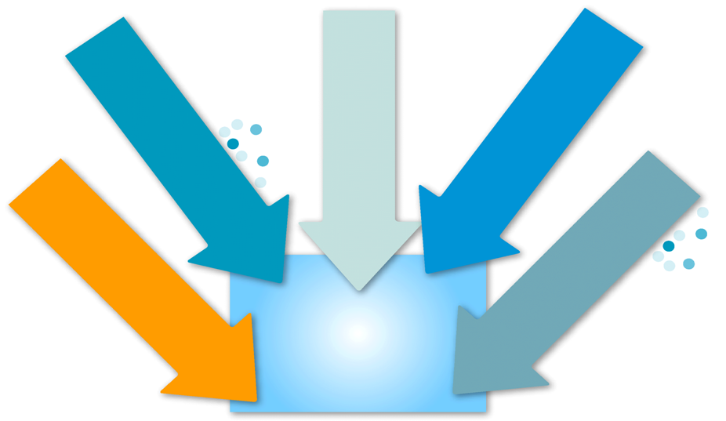
Test Process Improvements: Rapid Reports
Product Risk
Product Coverage
Agreement
Mission
Tasks
Client
satisfaction
Notes:
Often in rapid or compressed projects, people don’t want a lot of information. They usually want answers to specific questions such as:
What is the status of testing
What are you doing today
When will you be finished
Why is it taking so long
Have you test _____ yet
Management often has little patience for detailed test status reports. Many have little understanding of testing. Little understanding of impact of regression testing, metrics often hard to interpret, assume that you are testing continuously and exhaustively,

Slide 19
Testing Dashboard
Testing Dashboard Date: 3/21 Ver. 1/30/AE
Area | Effort | Coverage | Quality | Comments
GUI | Low | 3
Workflow | High | 1+
Tools | blocked | 1 |  | broken
Process Claim | Start 1/12 | 0
Error Msg | High | 2+ |  | # 54, 50, 66
Copyright © James Bach, Rapid Software Testing.
Notes:
A testing dashboard by James Bach provides a quick and visible status indicator for testing that doesn’t require a lot of work to put in place. This can be placed some where visible for all to see, or can be sent around. This dash board looks at the product areas compared to test effort, coverage, and quality assessment, compared to time.
15-30 items
Items represent test coverage
Items are approximately equal
Include product items & risks
Items should make sense
None Not testing, not planning to test
Start No testing yet, but expect to start soon
Low Regression or spot testing only
High Focused testing effort; increasing coverage
Pause Temporarily ceased testing; is testable
Blocked Can’t test due to blockage
Ship Going through final test & signoffs
0 No good information in this area
1 Sanity Check : Major functions & simple data
1+ More than sanity, but many functions not tested
2 Common & Critical all functions touched; common & critical tests executed
2+ Some data, state, or error coverage beyond level 2
3 Complex cases: strong testing

Slide 20
Test Process Improvements: Risk Based Testing Strategy
Process
Testing Risk
Analysis
Requirements Risk
Analysis
Project
Product
Schedule
Resources
Technology
Business
Risk-Based Testing Analysis
Notes:
Risk is defined by Webster as the “possibility of suffering loss”. Possibility is the key word here. Risk analysis is the process of looking at the project to determine the possible problems which could derail, hamper, or cause failure on a project.
Risk Analysis is vital to the development of a sound test plan. Managing risks effectively is crucial to all projects but even more so on time-constrained projects. For the RBDT methodology, we will be looking at risk analysis from two perspectives.
Project Risk: Those risks that affect the project or the ability of the test team to perform their tasks on the project plans. The Testing Risk Analysis Checklist is the input for this process. The following slides will review a risk assessment approach designed to quickly review risk and profile the risks for the project.
Product Risk: Risk-based testing analysis is a process of comparing logically equivalent elements and reaching an understanding of the best return that can be made when time and money preclude testing all facets of the product (application). Requirements risk analysis is the input here. The purpose of business risk analysis during software testing is to identify the high-risk application components that must be tested thoroughly and to identify error-prone components within specific applications.

Slide 21
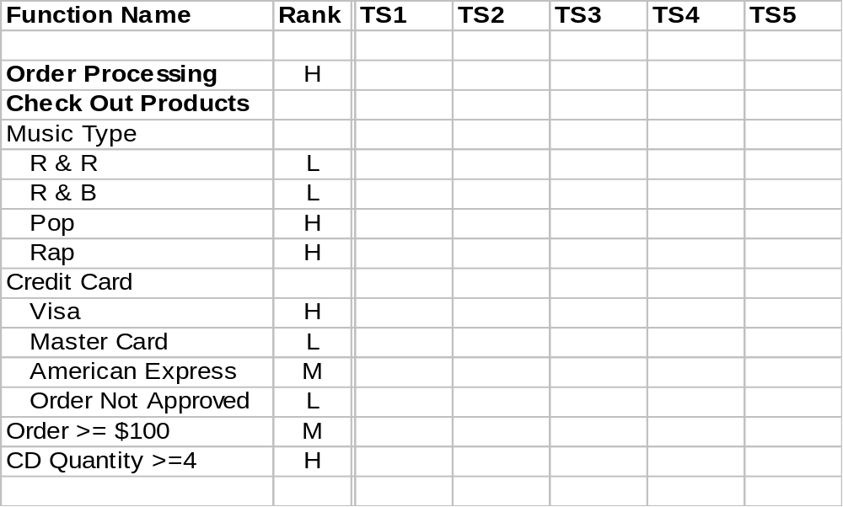
Requirements Risk Analysis Rank
Notes:
This risk analysis involves analyzing the relative risk of each feature. Basically it involves assigning a value to each feature for probability of failure, as well as a value for impact of failure. You may want to use High, Medium and Low as a way of rating the probability and impact of failure of each feature. It will become very obvious that the features that have HH (denoting high probability and high impact) will have the greatest software risk, while those with a rating of LL will have the lowest. Somewhere in the middle we have ratings for MM, HL, LH, HM, etc.
You could argue that this method is subjective and you might be right (actually the rating might be objective if they’re based on number of customers, dollars, software complexity, etc.). It is not necessary, however, to rank every feature from 1 (the highest risk) to X (the lowest risk). What is important is to break the risk of the features into a few categories (e.g., High, Medium and Low). This allows us to focus our testing on the High Risk features first, then the Medium Risk features and leave the Low Risk features to last. A finer measure is not really required for most projects. An added benefit of assigning a risk rating to each feature is that it can help determine which low risk features to move to Features Not to Be Tested when your project begins to get behind schedule.
It is important that you communicate to the client that they need to make the decisions on the priorities.

Slide 22

Test Execution
High Risk Functions First
Core functions: critical and popular
Capabilities: which ones work
Common situations: popular data & paths
Common threats: stress & errors
User impact: failures with high impact
Most wanted: special interest by stakeholders
Modified slide Originally from James Bach,
Rapid Software Testing.

Slide 23
Test Process Improvements: Design for Test Automation
Improve system reliability
  Improved requirements definition
  Improved performance & stress testing
  Improved testing repeatability
Reduction Test Schedule
  Less time to run than manual
  Less time result analysis
  Less time for reporting
Improved quality of test effort
  Build verification – via smoke test
  Static and dynamic testing of code
  Regression testing
Notes:
The test data for a project are the elemental levels of information, each containing a value to be applied to the system in order to test the application or infrastructure.
Test data must be related to an expected result in order to be meaningful.
Values for each test data item are derived during the development of test cases based on detail level requirements.
Consider using a test data generator. There are many types of test data generators. Some help develop test cases by deriving a set of non-redundant test inputs from the description of a code unit's specification. Others generate random sets of data values, and format them to be used as an input file to another code unit. Some generators do more than create test data; for example, they can interface directly with a database product to create a test database. This is a very important feature when a database product is being used with the development project.
In addition to reducing the effort to create test data, there are other advantages to using test data generators:
Testing can begin earlier for some code units that are dependent on others for data. The use of a test data generator can move this dependency from the development of code to the execution of a test tool, permitting earlier testing of the dependent software.
The cost of software fixes can be minimized. As resources are freed from the time-consuming task of preparing test files, more resources can be devoted to testing. Errors are found sooner, and so costs are lower.
When resources are not tied up in the preparation of test data, there may be more time available for test implementation.
A test data generator can be used as a permanent test facility, aiding maintenance and regression testing. The generator can produce test data for a test bed and then maintain it. In addition, the original test cases used to validate the code unit can easily be recreated.
The use of a generator can maximize the achievement of coverage goals. For example, while a coverage tool can reveal requirements not covered by test cases, a test data generator can produce test data that will satisfy those requirements.

Slide 24

Dynamic Testing: Gaining Efficiencies
Metrics Driven
Scenario approach
Exploratory Testing
Check list driven
Notes:
The next series of modules will discuss the third block in the structured testing process. Dynamic Testing. We will look at four techniques, exploratory driven testing, checklist driven, metrics driven and scenario

Slide 25
Test Execution: Test Scenarios Vs. Test Cases
Scenarios
Minimal documentation
General, by activity
Results defined at execution
Test Cases
Extensive documentation
Detailed step by step
Results defined when created
Notes:
Scenario testing is not new. System and user acceptance testing have traditionally used scenario approach for the basis of testing. What is new is that the development and maintenance of detailed step-by step test cases is sometimes infeasible for time-constrained projects. There simply isn’t time to fully decompose and document requirements to a detail-level, much less develop and maintain test cases with expected results and data values for an often-changing application. In these situations we recommend using the test scenario approach to testing.
One of the differences with the scenario based approach is that the focus is on the end users and how they will use the application. Make sure you have this information available by the time you began to do the risk analysis of the requirements.
Although we recommend scenarios as a course of action, it is important that the client understands that there is a different risk exposure level when testing based on intermediate-level versus detail-level requirements.
Comparing Test Scenarios to Test Cases:
Test Scenario Test Case
Requirement decomp Intermediate Detail
Documentation Minimal Extensive
Test Preparation Activity by activity Step by step
Test Data General, selected at Detailed, comprehensive,
execution time pre-specified
Expected Result Generic - not specifically Specific - defined at test
defined until execution case creation
Knowledge of application Yes No
required to execute

Slide 26
Samples – Scenario vs. Test Case
Action: Expected Result:
Scenario:
Search by artist – in db Valid results returned
Test Case:
Click down arrow on search Menu appears- ‘Artist,
combo box Album Title, Music Type’
Select ‘Artist’ ‘Artist’ appears in combo box
Enter ‘Santana’ in search text ‘Order’ page is returned with 3
box, click ‘Search’ button entries- ‘Santana – Abraxas,
Santana – Santana, Santana
Supernatural’. Check box is
unchecked, Quantity is ‘1’,
etc., etc.
Notes:
As shown, a test case is much more detailed than a scenario, although both list ‘actions’ and ‘expected results’.
When testing with scenarios, the expertise of the tester is most critical at execution time – development is done in very general terms.
When testing with test cases, the expertise of the tester is most critical during development of the test cases – no knowledge of the application or data is needed to execute a well-written test case.

Slide 27

Dynamic Testing Efficiencies:
Checklist Driven Testing
Checklist driven testing
  Collect wide variety of checklists
  Organize & manage checklists
    Ease of use
    Ease of update
Notes:
Checklist Testing
Checklists are a straightforward way of documenting simple re-usable tests. Not enough use is made of checklist driven testing, perhaps because it is perceived to be trivial, but it is their simplicity that makes them so effective and easy to implement. They are best used to document simple checks that can be made on low-level components. Ideally, these checks can be made visually, or by executing very simple or easily remembered series of commands. The types of checks that are best documented in this way are:
Programming/GUI standards covering standard features such as:
window size, positioning, type (modal/non-modal)
standard system commands/buttons (close, minimize, maximize etc.)
Application standards or conventions such as:
standard OK, cancel, continue buttons, appearance, color, size, location
consistent use of buttons or controls
object/field labeling to use standard/consistent text.
These checks should be both simple to document and execute and can be used for standalone components so that programmers may make these checks before they release the code for integration.
Checklist driven testing can speed up approach to test case design. However does require systematic organization. When checklists are classified according to a common focus, can pickup appropriate or suitable checklists quickly. If updates are necessary know which checklist needs updating

Slide 28
Dynamic Testing Efficiencies:
Exploratory Testing
Involves simultaneously learning, planning, running tests, and reporting/troubleshooting results” (Dr. Cem Kaner (2001)
Exploratory testing is an interactive process of concurrent product exploration, test design and test execution. To the extent that the next test is influenced by result of the last test. (James Bach, Satisfice (2001)
Notes:
Rapid Testing is based on exploratory testing techniques, which means that the tester has a general test plan in mind but is not constrained by it. The plan can be adapted on-the-fly in response to the results obtained for previous tests. The downside is that it is not possible to guarantee total test coverage, but the benefit is that a skilled tester can quickly hone in on faults that would have eluded a scripted test. We often refer to exploratory testing as 'expert testing' as it requires a high level of technical knowledge and experience to be effective.
Rapid Testing extends the exploratory concept by making judgments about what faults to report and the level of detail to record. Once a fault has been identified, the time taken to investigate and document it reduces the time available to find other faults, so the tester may fail to find the serious faults if they spend too much time reporting less important issues. We refer to this as the 'quality threshold' and it is fundamental to the effectiveness of Rapid Testing. Many testers find it an alien concept but it is a necessary one.
The tester will consult with the customer to determine the initial quality threshold, but it is often necessary to vary it during the course of testing depending on the product quality. If the overall product quality is good it may be possible to reduce the threshold and investigate the less serious faults.

Slide 29
Elements of Exploratory Testing
Product exploration
Test Design
Test Execution
Heuristics
Reviewable Results
Notes:
Exploratory testing is an interactive process of concurrent product exploration , test design and execution. The outcome of an exploratory testing session is a set of notes about the product, failures found, and a concise record of how the product was tested. Used with trained testers, yields consistently valuable and auditable results.
Product exploration- discover and record the proposes and functions of the product, types of data processed, and areas of potential instability.
Test design- determines strategies of operating, observing and evaluating the product.
Test execution: operate the product, observe its behavior, and use that information to form hypothesis about how the product works
Heuristics: are guidelines or rules of thumb that help you decide what to do ..
Review able results: exploratory testing is a results-oriented process. It is finished once you have produced deliverables that meet the specified requirements.

Slide 30
Test Execution Rapid Test Cycle
STOP
Do a burst of
testing
Start
Focus on what
Needs doing
Report
Make sense
Of your status
Compare status
Against mission
Copyright © James Bach,
Rapid Software Testing.
Notes:
Use time before and after testing cycles wisely
Sequence test scenarios as efficiently as possible
Stay close to your users and developers before, during, and after each test cycle
Allocate some time for adhoc testing with other personnel

Slide 31

When can testing stop?
Metrics can support the decision

Slide 32
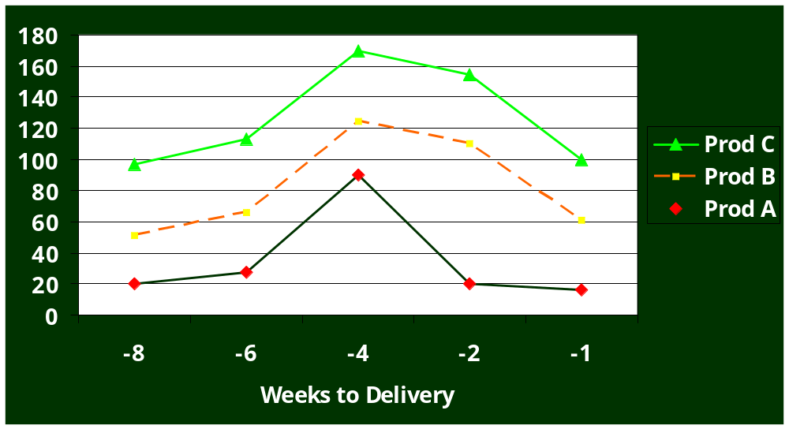
Defect Arrival Rates
Notes:
Can compare relative to general arrival date on single product or among releases. How do they peak. Do they decline in normal expected fashion.

Slide 33
Static Testing
Quickest bug
Is in Work
Products
Notes:
Remember static testing is done to validate that a work product properly implements system requirements and verifying the quality of the work product. Most effective means of quickly detecting and fixing a bug is in the early stage of sw development in the stage the defect was introduced.
If you want rapid testing with high quality. Test your requirements and design doccs

Slide 34
Summary: Looking For Efficiencies & Rapidity
Rapid Testing
People
Integrated
Test
Process
Static
Testing
Dynamic
Testing
Rapid Testing: Brown, Cob, Culvetson ,Prentice Hall, 2002
Notes:
There is no simple way to achieve rapid testing. This slide presents rapid testing as a structure built on 4 components. These components, people, integrated test process, static testing and dynamic testing represent the central activities of a structured testing process. If any are weak, then effectiveness of rapid testing is impaired. For rapid testing must optimize these four components in order to gain efficiencies that you normally don’t have when employing structured techniques.

Slide 35
Class References
Rapid Testing. Robert Culbertson, Chris Brown, Gary Cobb. Prentice Hall. 2002
Rapid software Testing (course notes, Fall 2002). James Bach, www.testing-education.org
Risk Based ebusiness Testing. Paul Gerrard, Neil Thompson. Artech House. 2002
General Functionality and Stability Test Procedure. James Bach. Satisfice
Exploratory Testing. Amland Consulting. ET Workshop v.1.20.
An Exploratory Testing Workshop Report. Bret Pettichord, July 19, 1999.
A Closer Look at Estimating Testing Process. STQE, Oct. 2002, Louri Kroukov.

Slide 36

Questions?
???
???
cchaney@ppc.com

